Slide 1
The Sabbath Through the Centuries
By Randall Ricker Sabbath Church of God
THE SABBATH AND FESTIVALS
The Sabbath is the God-ordained day of rest and worship. Christ observed the Sabbath (Luke 4:14-16, Mark 2:27-28), as did the apostle Paul (Acts 13:14-15, 42-44).
All Scripture quotations, unless otherwise indicated, are taken from the New King James Version®. Copyright © 1982 by Thomas Nelson, Inc. Used by permission. All rights reserved.

Slide 2
Council of Nicea 325 AD
Luke 4:15-16 15 And He taught in their synagogues, being glorified by all. 16 So He came to Nazareth, where He had been brought up. And as His custom was, He went into the synagogue on the Sabbath day, and stood up to read. Acts 13:42-44 42 So when the Jews went out of the synagogue, the Gentiles begged that these words might be preached to them the next Sabbath. 43 Now when the congregation had broken up, many of the Jews and devout proselytes followed Paul and Barnabas, who, speaking to them, persuaded them to continue in the grace of God. 44 On the next Sabbath almost the whole city came together to hear the word of God. Hebrews 4:9 There remains therefore a rest [4520 sabbatism] for the people of God.

Slide 3
The Sabbath as a Sign
Exodus 31:13, 16-17 13 "Speak also to the children of Israel, saying: 'Surely My Sabbaths you shall keep, for it is a sign between Me and you throughout your generations, that you may know that I am the LORD who sanctifies you…16 Therefore the children of Israel shall keep the Sabbath, to observe the Sabbath throughout their generations as a perpetual covenant. 17 It is a sign between Me and the children of Israel forever; for in six days the LORD made the heavens and the earth, and on the seventh day He rested and was refreshed.' "

Slide 4
Sabbath Keepers in the Fifth Century
“Down even to the fifth century the observance of the Jewish Sabbath was continued in the Christian church, but with a rigor and solemnity gradually diminishing.” Coleman, Ancient Christianity Exemplified. Quoted in Dugger and Dodd, A History of the True Religion. “The Pauliani [AKA Paulicians, condemned as heretics in the fifth century], who were the same people at an earlier date, were Quartodecimans, and kept Easter in the primitive manner at the Jewish date. John of Otzun’s language perhaps implies that the old believers in Armenia during the seventh century were Quartodecimens, as we should expect them to be… The Sabbath was perhaps kept and there were no special Sunday observances.” Dr. Fred Coneybeare translation of The Key of Truth. Quoted in John Ogwyn, God’s Church Through the Ages. Later, many adopted customs of the Roman church.

Slide 5
Sabbath Keepers in the 6th through 11th Centuries
The Vaudois (Valley Dwellers) fled to northern Italy and southern France. They observed the seventh day Sabbath, baptized by immersion, and kept the Passover once a year in the first month. They were later called Waldensians. 692 AD Pope Justinian II called the sixth general council. It condemned Saturdays. 8th century Paulicians were resettled in the Balkans. They were called Bogomils. They spread to Piedmont and Lombard Italy, and southern France. They kept the Sabbath and rejected the trinity. Later many converted to Islam. 1104 Peter de Bruys preached among Bogomils in Piedmont valleys of southeastern France.

Slide 6
The Waldensians in the Twelfth Century
1161 Peter Waldo preached in Lyons France, then in northern Italy. The Waldensians kept Passover only once a year. http://waldensiantours.com

Slide 7
The Waldensians in the Twelfth Century
“Investigators made a report to Louis XII [reigned 1498–1516], king of France, that they had visited all the parishes where the Waldenses dwelt. They had inspected all their places of worship… but they found no images, no sign of the ordinances belonging to the mass, nor any of the sacraments of the Roman church.… They kept the Sabbath day, they observed the ordinance of baptism according to the primitive church, ... They despise the Feast of Easter, and all other Roman festivals of Christ and the saints” William Jones, A Handbook of Church History.

Slide 8
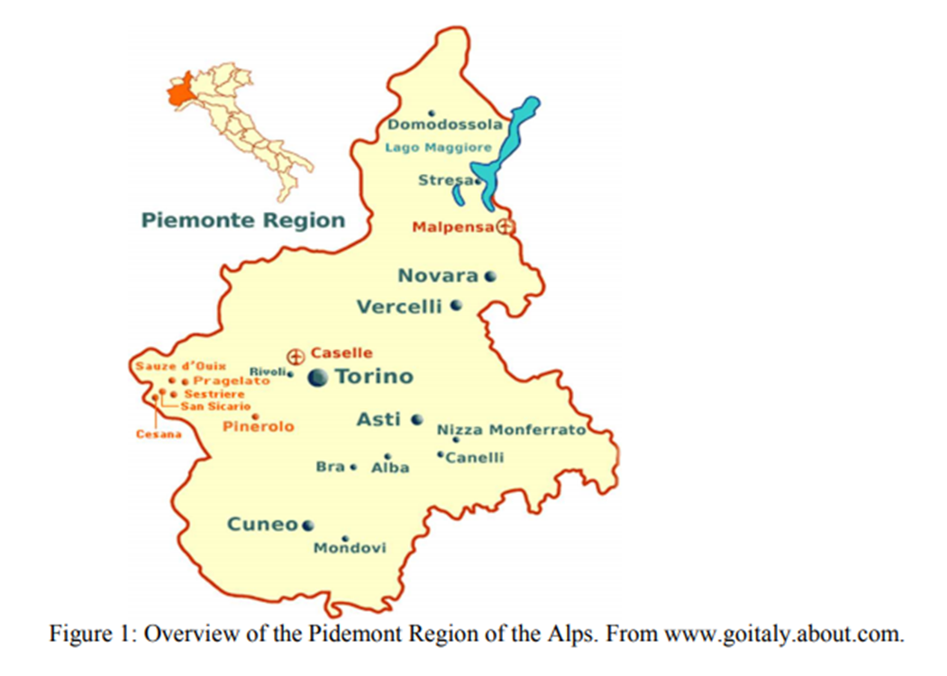
The Waldensians in the Twelfth Century

Slide 9
The Waldensians in the Twelfth Century
“Their enemies confirm their great antiquity. Reinerius Saccho, an inquisitor, and one of their most implacable enemies, who lived only eighty years after Waldo, admits that the Waldenses flourished five hundred years before that preacher (600 A.D.), Gretzer, the Jesuit, who also wrote against the Waldenses, and had examined the subject fully, not only admits their great antiquity, but declares his firm belief that the Toulousians and Albigenses . . . were no other than Waldenses.’ In fact,
their doctrine, discipline, government, manners, and even the errors with which they have been charged [by the Catholics], show that the Albigenses and Waldenses were distinct branches of the same sect, or that the former sprang from the latter.”
— Dr. Rankin’s History of France, vol. III; Jones’ Church History

Slide 10
The Waldensians in the Twelfth Century
“The method which Allix has pursued in his History of the Churches of Piedmont, is to show that in the ecclesiastical
history of every century, from the fourth, which he considers a period early enough for the enquirer after apostolic purity of
doctrine, there are clear proofs that doctrines unlike those which the Roman church holds, and conformable to the belief of
the Waldensian and Reformed churches, were maintained by theologians of the north of Italy down the period when the
Waldenses first came into notice. Consequently the opinions of the Waldenses were not new to Europe in the eleventh or
twelfth centuries, and there is nothing improbable in the tradition, that the Subalpine Church persevered in its integrity in an
uninterrupted course from the first preaching of the Gospel in the valleys.” — Gilly, Waldensian Researches

Slide 11
The Waldensians in the Twelfth Century
“The Waldenses were among the first of the people of Europe to obtain before the Reformation, the possession of the Bible in Manuscript of their native tongue. They had the truth unadulterated, and this rendered them the special objects of hatred and persecutions. . . . Here for a thousand years, witnesses for the truth maintained the ancient faith . . . in a most wonderful manner it (the Word of Truth) was preserved through all ages of darkness.” — Wilkinson, Our Authorized Bible Vindicated

Slide 12
The Waldensians in the Twelfth Century
c. 1170 AD “Information of these things (the ministry of Waldo) was then conveyed to Pope Alexander III, who no sooner heard of such heretical proceedings than he anathematized the reformer and his adherents, commanding the archbishop to proceed against them with the utmost rigor. Waldo was now compelled to quit Lyons. His flock in a great measure followed their pastor; and hence a dispersion took place not unlike that which arose in the church of Jerusalem on the occasion of the death of Stephen. The effect is also similar. . . . His (Waldo’s) principles took deep and lasting root, and produced a numerous
harvest of disciples, who were denominated Leonists, Vaudois, Albigenses, or Waldenses, for the very same class of Christians is designated by these various appellations at different countries, or
quarters of the same country, in which they appeared.” Jones’ Church History, ed. 1837

Slide 13
The Waldensians in the Twelfth Century
“the general body of the Albigenses received the doctrines of Peter Waldo, . . .and that the Waldenses and Albigenses were two branches of the same sect. . . .”Jones’ Church History, ed. 1837 “The Latin vulgate Bible was the only edition of the sacred book at that time in Europe: and, the languages then in common use, the French and others, however, mixed with the Latin, were, properly speaking, by this time separate and distinct from it. It appears that the Christian world under providence, was indebted to Waldo, for the first translation of the Bible into a modern tongue.” Townsend’s Abridgment 1179 Peter Waldo died in Bohemia.

Slide 14
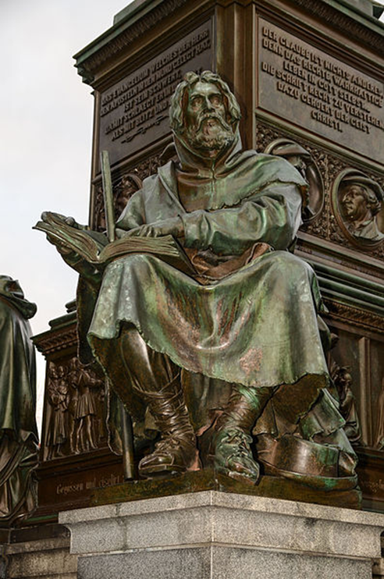
The Waldensians in the Twelfth Century
1868 statue of Peter Waldo at the Luther Memorial in Worms, Germany

Slide 15
The Waldensians in the 13th through 15th Centuries
13th Century: Waldensians in 22 countries of Europe, including Britain. 1224 Emperor Frederick II of Rome: “We condemn to perpetual infamy, withdraw our protection from, and put under our ban, the Puritans, Paterines, Leonists, Arnoldists, Josephines, Albigenses, Waldenses, etc., and all other heretics, of both sexes, and of whatever name.” — Jones’ Church History “The council of Toulouse established the inquisition to complete the work of heresy; and in the year 1229, first forbade the use of the Scriptures in the vulgar tongue.” — Orchard, Hist. Of Bap., 1315 80,000 Waldensians in Bohemia 1487 Pope Innocent VIII ordered the Vaudois in Piedmont to be killed.

Slide 16
The Waldensians in the Sixteenth Century
“The Reformers (Luther, Calvin, Knox, and others) with all their zeal and learning, were babes in spiritual knowledge when compared with the Waldenses, particularly in regard to the nature of the kingdom of
Christ, and its institutions, laws, and worship in general…In A.D. 1530 one of the pastors of the Waldenses, George Morel, published the memoir of his church. He said there were then 800,000. ” Jones Church History

Slide 17
The Waldensians in the Sixteenth Century
1552 Waldensians still kept Sabbath. 1559 “They implored his highness to consider that their religious profession was not a thing of yesterday, as their adversaries
falsely reported, but had been the profession of their fathers, grandfathers, and great-grandfathers, yea, of their predecessors
of still more ancient times, even of the martyrs, confessors, apostles, and prophets; and they called upon their adversaries to prove the contrary if they were able. Persuaded, therefore, as they were, that their religion was not a human invention, but founded upon the Word of God, which shall remain forever, they were confident that no human force would be able to extinguish it.” Jones Church History In the late 16th Century, MANY WERE ASSIMILATED by the Lutherans!

Slide 18
The Waldensians in the Seventeenth Century
1665 Oliver Cromwell in defense of Waldensians in Savoy: “But if, on the other hand, he shall continue firmly resolved utterly to destroy and to drive to a state of distraction those men, among whom our religion was either planted by the first preachers of the gospel, and so maintained in its purity from age to age, or else reformed and restored to its primitive purity more early than among many other nations, we hereby declare ourselves ready to advise, in common with you, and the rest of our brethren and allies of the reformed religion, by what means we may most conveniently provide for the preservation and comfort of these distressed people.” Jones’ Church History

Slide 19
The Lollards in the 14th through 16th Centuries
1315 Walter Lollard preached the doctrines of the Waldensians. “They now abounded; more than half of the nation became Lollards; yea, they covered all England. In 1389 they formed separate and distinct societies agreeable with Scripture… Their hostility to the hierarchy, and their numbers, aroused their enemies to adopt severe measures. In the year 1400, a law was passed sentencing Lollards to be burned to death. In Norfolk they abounded, and there they suffered severely. Still the “Bible men” increased, and became dangerous to the Church. They are said to have numbered 100,000. Henry VIII, while in conflict with the Pope, relieved and encouraged the Lollards in his kingdom: and this led their persecuted brethren from all parts of Europe to flock to England in great numbers, to enjoy religious liberty, and to strengthen the cause of true religion.” Benedict, History

Slide 20
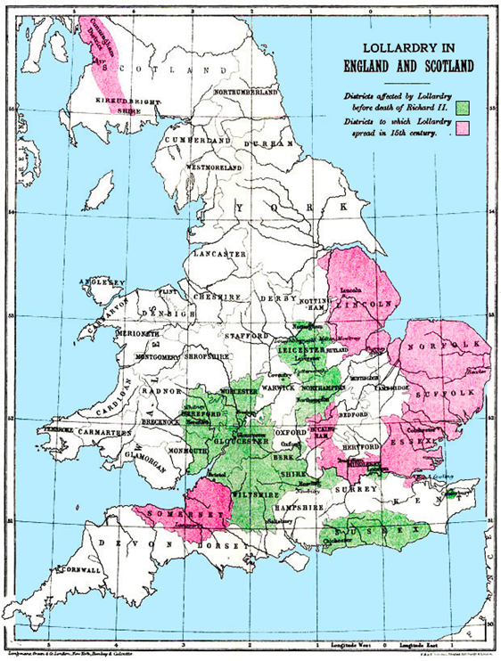
The Lollards in the Fourteenth Century Originally published in: G.M. Trevelyan, England in the Age of Wycliffe (London: Longmans, Green, 1909).From: http://www.lollardsociety.org

Slide 21
The Lollards in the 14th through 16th Centuries Beginning of the Gospel of John from a pocket Wycliffe translation that may have been used by a roving Lollard preacher (late 14th century)

Slide 22
The Sabbath in England in the 16th and 17th Centuries
“I find that the Pinners Hall Sabbatarian church was established at
Devonshire Square E. C., on March 1, 1574, and 1830 came to Mill Yard church to hold their services.” letter from Secretary George Vane of the Mill Yard church of London.
Mill Yard Church of London: “Origin. Some have supposed that this church owes its origin to the labors of John James who was martyred October 19, 1661. President Daland goes back as far as about 1580. In 1617 (or 1616) John Trask came to London from Salisbury and held revival meetings. One of his disciples, named Hamlet Jackson, was the means of bringing Trask and many, if not all, of his congregation to the observance of the seventh-day Sabbath in about 1617, and Elder William M. Jones says that this Traskite congregation was the origin of the Mill Yard Church.” History of Seventh Day Baptists

Slide 23
The Sabbath in England in the 16th and 17th Centuries present Mill Yard Church

Slide 24
The Sabbath in the 17th Century
1642, 1649, 1703 Anabaptists kept seventh day Sabbath and believed in the personal reign of Christ on earth during the Millennium. “In 1664 Stephen Mumford emigrated from England to Newport, Rhode Island. He brought with him the opinion that the Ten Commandments as they were delivered from Mount Sinai, were moral and immutable and that it was an antichristian power which changed the Sabbath from the Seventh to the first day of the week. He united with the Baptist church in Newport, and soon gained several of its members to the observance of the Sabbath.” Lewis, History of Sabbath and Sunday “We enter into a church covenant this 23rd day of December, 1671 (Old Stile), William Hiscox [pastor], Stephen Mumford, Samuel Hubbard, Rodger Baster, Sister Tacy Hubbard, Sister Mumford, and Sister Rachel Langworthy. “

Slide 25
The Sabbath in the 17th Century http://whatsupnewp.com /2015/08/oldest-buildings- in-newport-ri/5/ Stephen Mumford house

Slide 26
The Sabbath in the 17th Century https://www.flickr.com/photos/wallyg/1209108644 Church of God Newport

Slide 27
The Sabbath in the 18th and 19th Centuries
“When Count Zinzendorf, the founder of the Moravian church in
Germany, visited America in 1741, he was astonished to find the hold the Sabbatarian doctrine has upon the entire German population of Pennsylvania.” Corless F. Randolph’s History In present West Virginia “March 21, 1853, it was voted that communion service be held once in twelve months ‘on the fourteenth day of the first
Jewish month’; i. e., on the evening of the Passover.” Randolph’s History of the Seventh Day Baptists 1859 Wilbur Church of God organized in present West Virginia. They kept the Sabbath and Passover.

Slide 28
The Sabbath in the 20th Century
1900 General Conference of the Church of God incorporated in Stanberry, Missouri. Less than 1000 members. 1934 Herbert Armstrong began Radio Church of God and Plain Truth magazine.

Slide 29
The Sabbath in the 20th Century
From the minutes of the business meeting held in Detroit, Michigan, May 5–10, 1937, by the Board of Twelve Apostles of the Church of God (Seventh Day), Salem, West Virginia, Headquarters: “May 7, at 1:00 p.m. Reading of Elder Armstrong’s letter to the Twelve. Reading in periods of 20 minutes each of Elder Armstrong’s articles on the Feast of Unleavened Bread, the Passover, Pentecost, Feast of Tabernacles, etc., followed each time by discussion pro and con by the Elders.… A decision was made as given in the following resolution: ‘Inasmuch as some have troubled the Churches, teaching them they should observe the Feast of Unleavened Bread and yearly Sabbaths… we reaffirm the teachings of the Church of God on this point… that we observe no such custom… ’ It was in 1938 that he [Mr. Armstrong] was asked to turn in his credentials for continuing to preach contrary to Church doctrine.” John Kiesz, History of the Church of God

Slide 30
Should We Be Surprised that the Truth of the Sabbath Continued through the Centuries?
Hebrews 11:35-38 35 …And others were tortured, not accepting deliverance, that they might obtain a better resurrection. 36 Still others had trial of mockings and scourgings, yes, and of chains and imprisonment. 37 They were stoned, they were sawn in two, were tempted, were slain with the sword. They wandered about in sheepskins and goatskins, being destitute, afflicted, tormented-- 38 of whom the world was not worthy. They wandered in deserts and mountains, in dens and caves of the earth. Matthew 16:18 “… on this rock I will build My church, and the gates of Hades shall not prevail against it.”

